Slide 1

Finding a neighborhood to settle in the Big Apple
Daniel WOlK

Slide 2


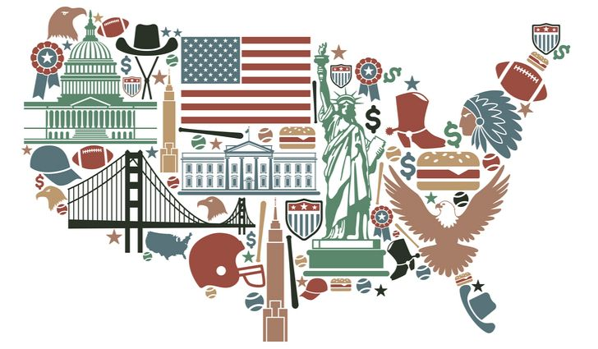
Background
Finance
GuY
American Culture
BIG City Life

Slide 3
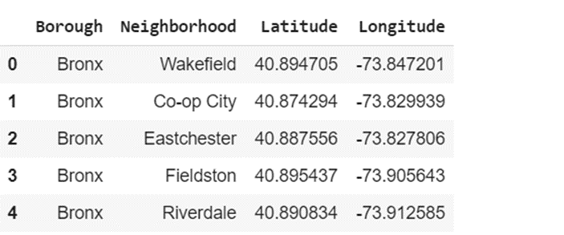
The Data Set
JSON file containing several areas of interest in New York City
Data source: data.gov
Clean Format, only latitude and longitude for each neighborhood need to be added

Slide 4
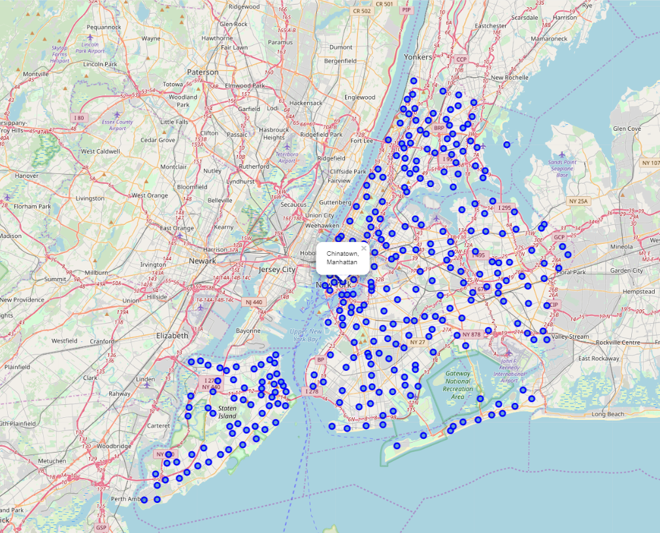
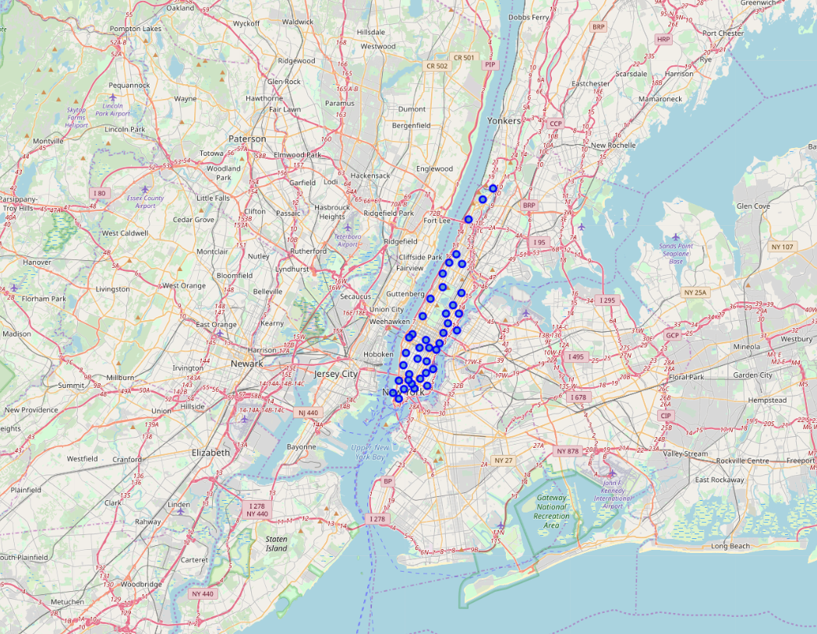
Plotting the first Maps
Display Neighborhoods in New York
Display Neighborhoods in Manhattan

Slide 5
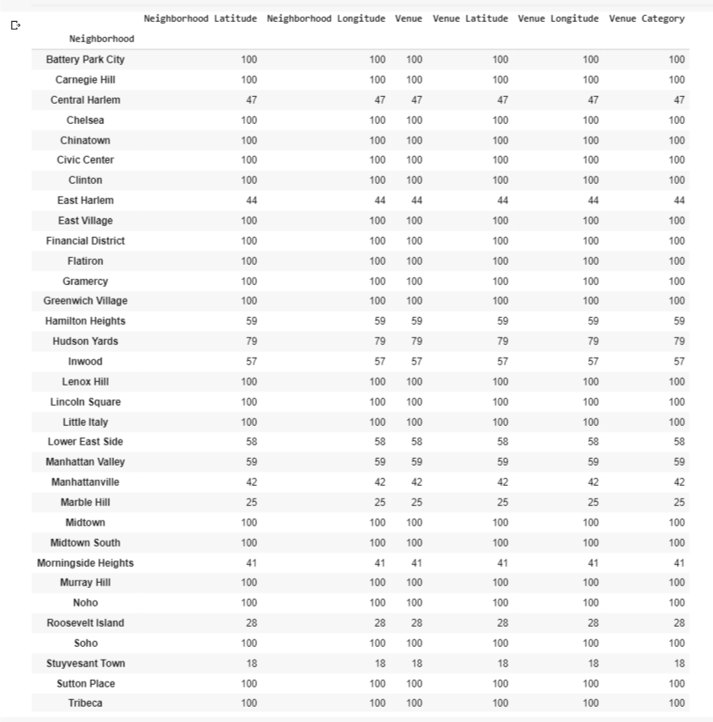
Make A Call to Foursquare API
-> 3324 venues in total over 40 neighborhoods

Slide 6
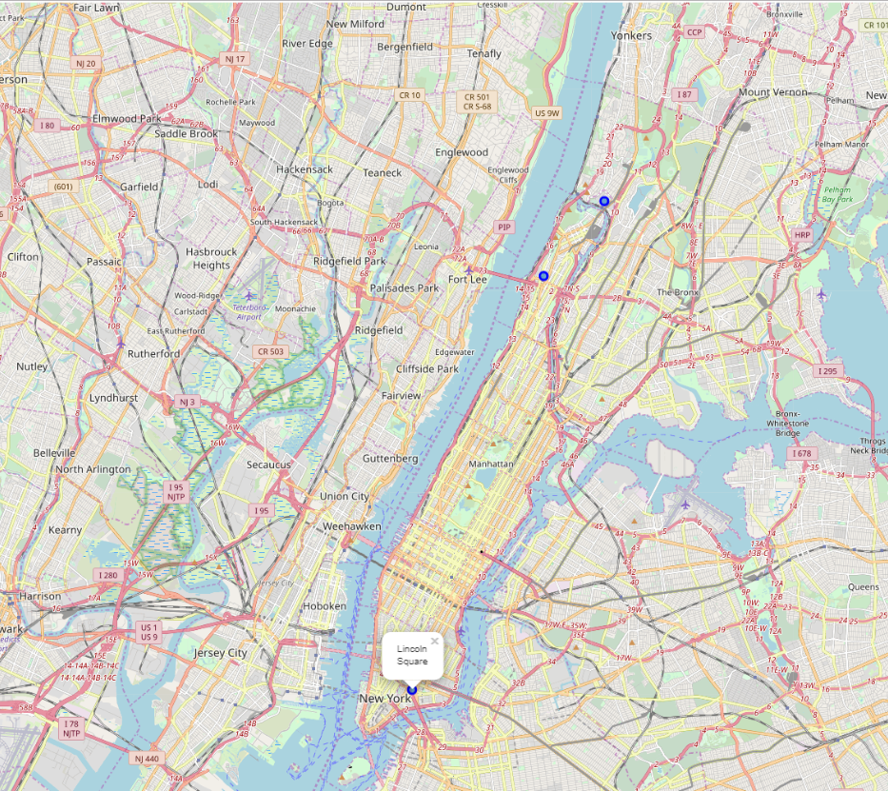
Result
-> The area with the most gyms is Lincoln square

Slide 7
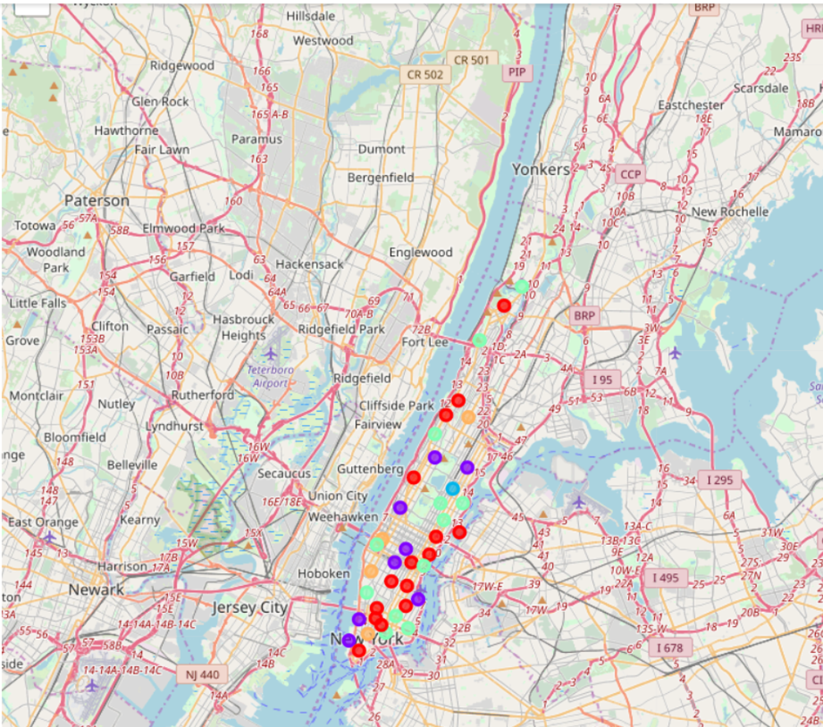
Discussion
Use K-Means to cluster different neighborhoods based on their most common venues

Slide 8

Conclusion
Variety of factors
Results depend on individual
ML-Model for more insights

Slide 9

Thank You

